Slide 1

Predictive model and its results

Slide 2
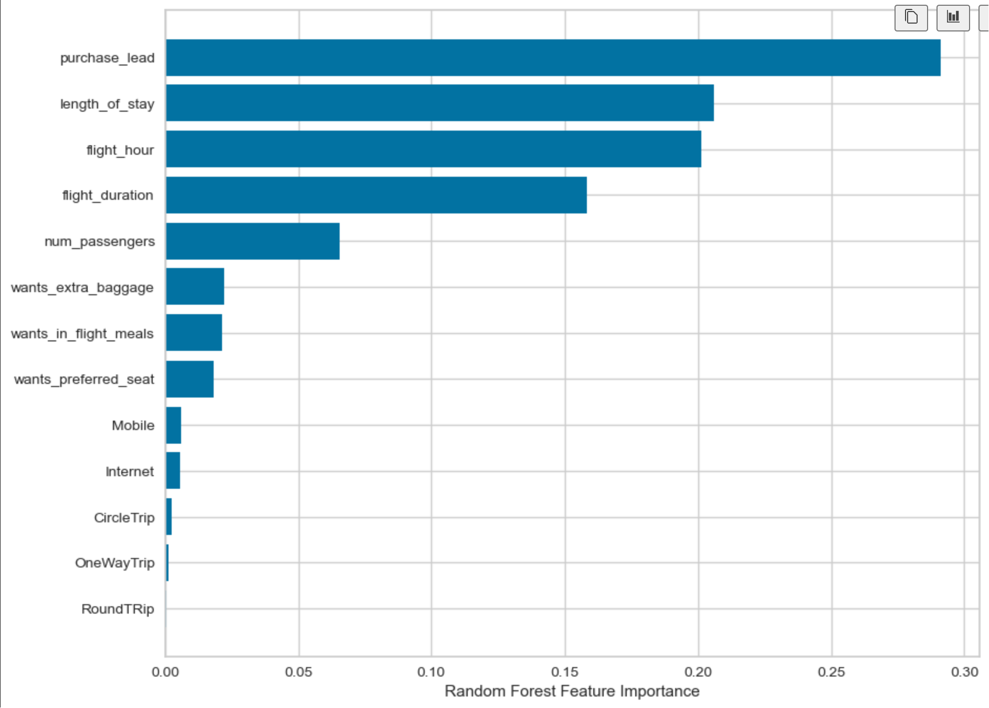
Results
We believe that we did not accurately predict the successful bookings. Although the imbalance dataset increases accuracy, it is unable to forecast successful bookings with any degree of accuracy. With 8,000 categorized as incomplete bookings and 7,000 as complete bookings, the dataset was balanced.
We believe that we did not accurately predict the successful bookings. Although the imbalance dataset increases accuracy, it is unable to forecast successful bookings with any degree of accuracy. With 8,000 categorized as incomplete bookings and 7,000 as complete bookings, the dataset was balanced.
Chance of predicting true successful bookings: 59%
Precision score: 62%
Accuracy: 62%
Chance of predicting true incomplete bookings correctly: 66%.
We believe that we did not accurately predict the successful bookings. Although the imbalance dataset increases accuracy, it is unable to forecast successful bookings with any degree of accuracy. With 8,000 categorized as incomplete bookings and 7,000 as complete bookings, the dataset was balanced.
Features that drive successful bookings

